Slide 1
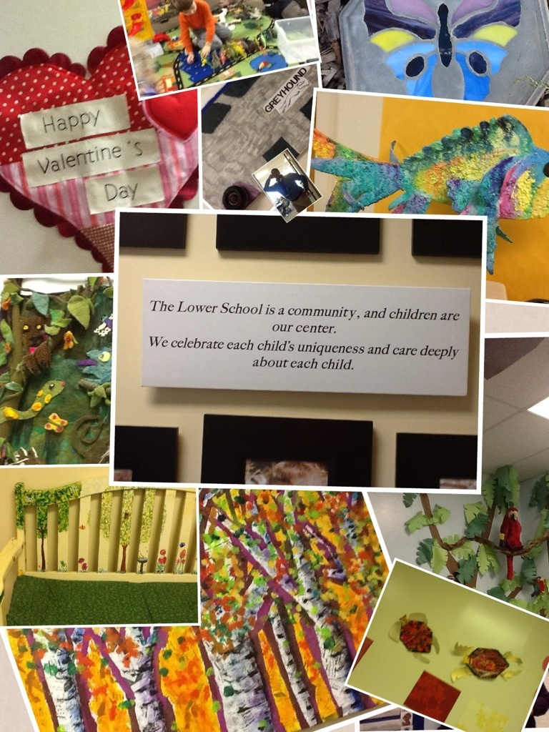
Technology in our Lower School

Slide 2
Student Blogs
Students blog in grades 1 through 5
Our goal is the integration of blog writing into the daily curriculum
The blogs also become a portfolio of student work and writing
This example is from a third grader

Slide 3
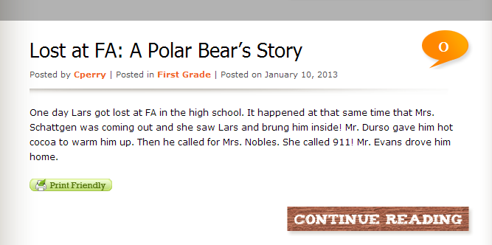
Our Youngest Bloggers
First grade students use “first grade spelling” to sound out words in their posts

Slide 4
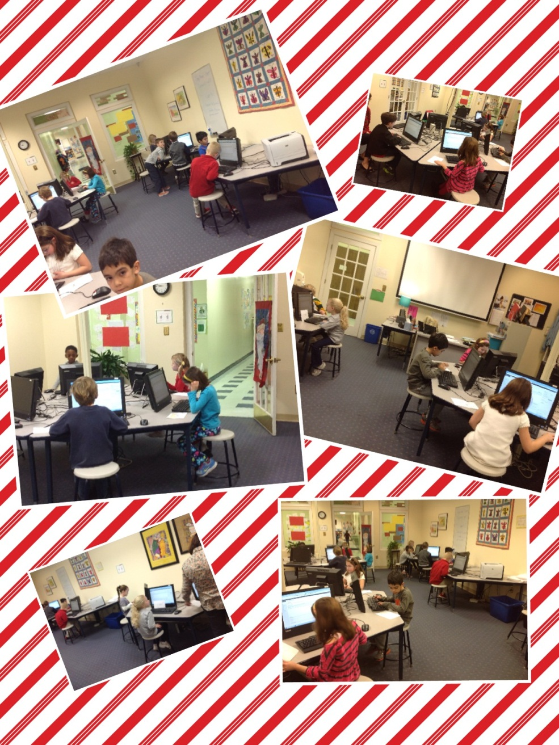
First Graders Working on Their Blogs
This collage was made using PicCollage on the iPad.

Slide 5
Blogging on iPads
The fifth grade has been blogging on iPads in their classrooms.
An app allows them to upload photos from their tablet to the internet.

Slide 6
Third Grade Uses Glogster (Digital Posters)

Slide 7
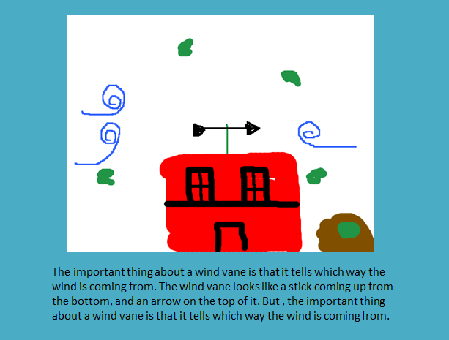
Fourth Grade Used PowerPoint and Tux Paint to Create Their Important Book of Weather

Slide 8
Kindergarten
Students demonstrate a knowledge of the difference between solids, liquids, and gases using Kidspiration software.

Slide 9
PK-4 Uses Skype
In December, PK-4 learned about Hanukkah by Skyping with a former Fredericksburg resident now residing in Israel.

Slide 10
Sharing
This second grade student is sharing her experiences from a wedding she attended in Pakistan. This excerpt is from the Lower School Weekly News.

Slide 11
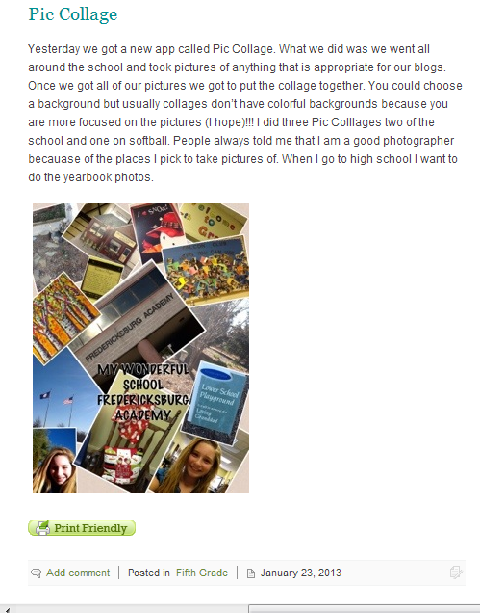
Using a New App: PicCollage

Slide 12
Fifth Grade Poetry
With technology in the classroom, students can create whenever they are inspired.

Slide 13
With Apple TV, they can share their creations.

