Slide 1
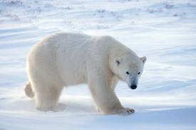
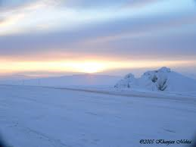
Tundra
By Sareena, Noah, Erin, and Harrison

Slide 2
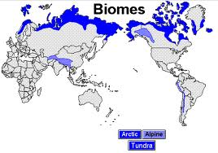
Tundra Biome Map Info
Arctic
Alpine
Canada, Alaska, Greenland, South America, Asia

Slide 3
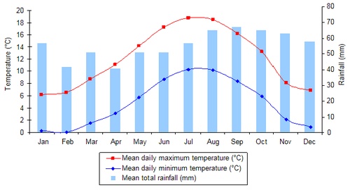
Tundra Biome Climates
Summer, winter
Summer short
Winter long
Highest temp. -18 degrees Fahrenheit
From winter to summer
Lowest temp. -70 degrees Fahrenheit
From winter to summer

Slide 4
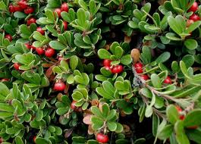
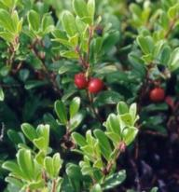
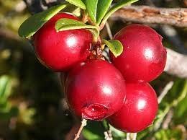
Bearberry
Bearberry, Foxberry, Kinnikinic
Stem 2-8” inches
Petal, pale pink or white
Berry non-poisonous

Slide 5
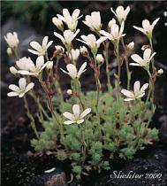
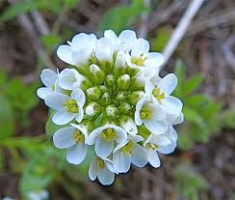
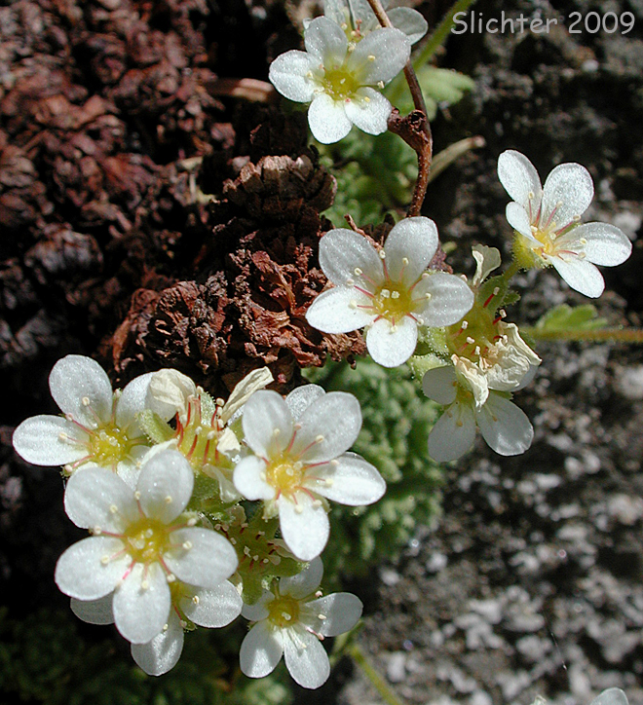
Tufted Saxifrage
Small perennial
Stems 3-15 cm.
2-10 petals each
Petals white
Several flowers each grass

Slide 6
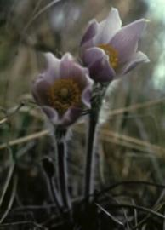
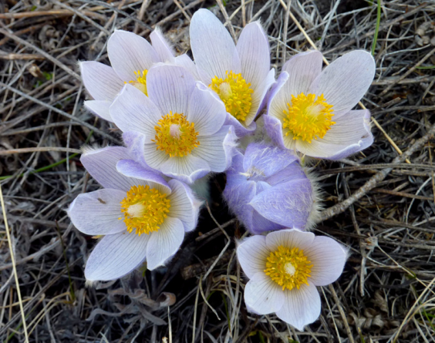
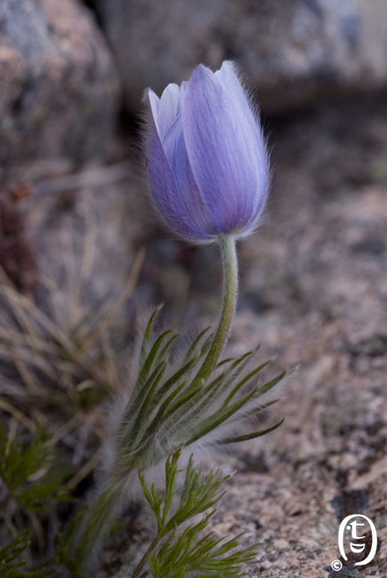
Pasque Flower
From Ranunculaceae family
Stem 6-8 inches
5-8 petals
Dark lavender or white
center yellow stamens

Slide 7
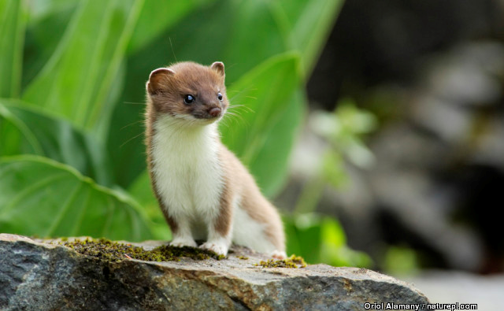
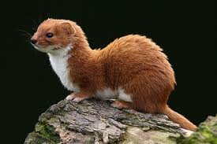
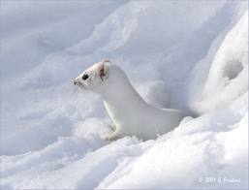
Ermine
Ermine, Short Tilled Weasel, Stout, Royskatt
Babies, 8 weeks, hunt
Females more protective
Males/babies
White, brown
Rabbit, rodent, insect

Slide 8
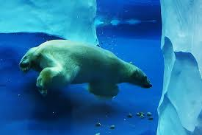
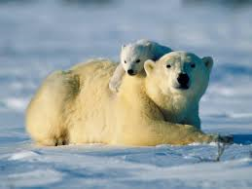
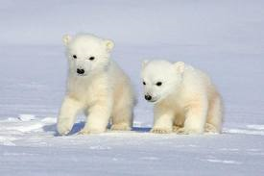
Polar Bear
Polar Bear, Sea Bear
2 layers, fur
Largest carnivores
Seals, other sea life
Litter 2-4

Slide 9
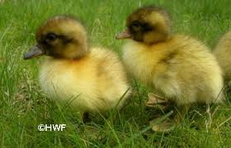
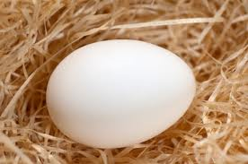
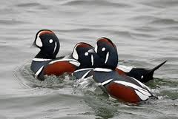
Harlequin Duck
Male dark, female not as colorful
Wings rapidly
Eggs 27-29 days
Fish, shellfish, aquatic insects

Slide 10
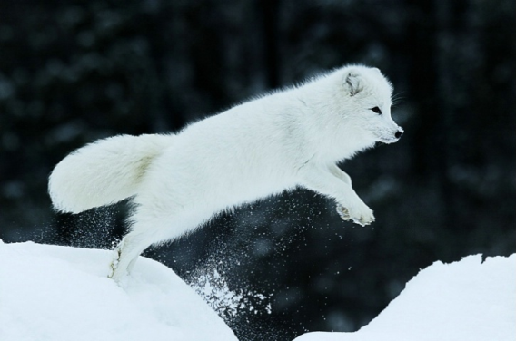
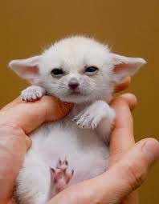
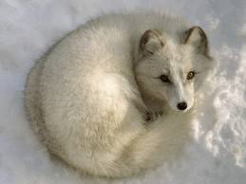
Arctic Fox
Arctic Fox, Polar Fox, White Fox
10-16 inch. long, 6-15 lbs.
Female pregnant 52 days
Omnivore, birds, eggs, small mammals, fish
Berries, seaweed, insects, larvae
Sleep curled, to stay warm

Slide 11
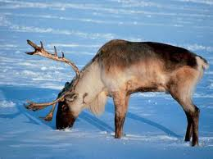
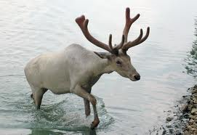
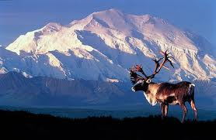
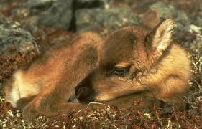
Caribou
Caribou, Reindeer
Female, Male antlers
Lichens, dried sedges, small shrubs, leaves, mushrooms
Babies every year

Slide 12
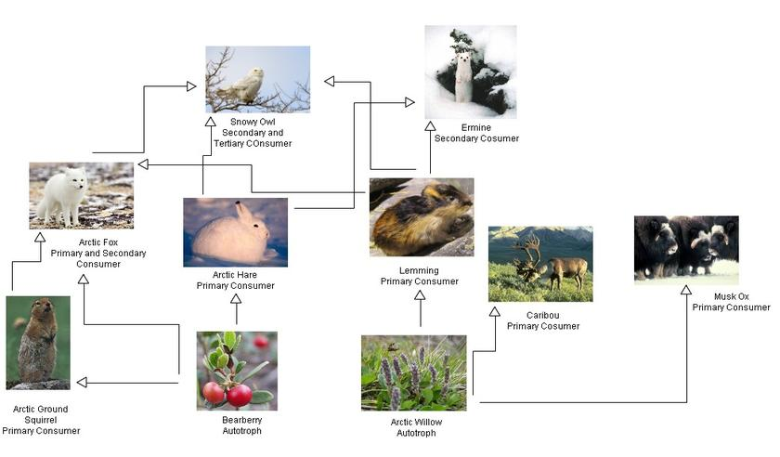
Tundra Food Chain
Polar bear top
fox, owl
Hare, lemming, squirrel, ermine
Berries bottom

Slide 13
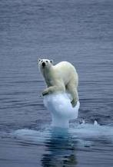
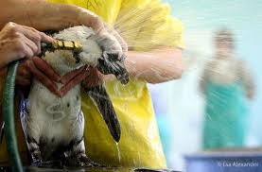
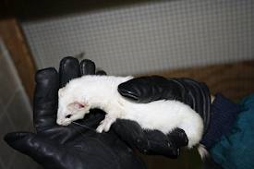
Human Interference
Climate few interference
Worlds most fragile ecosystems
Poachers kill
Global Warming
Out of the tundra

Slide 14
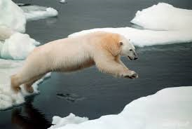
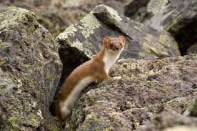
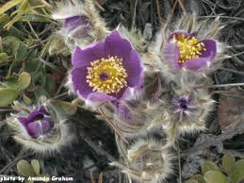
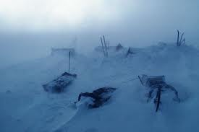
Conclusion
Fun, interesting, cold
Fascinating animals
dangerous climate
Pretty plants

Slide 15
Resources
http://www.blueplantsbiome.org/tundra_plants_page.htm
http://www.blueplanetbiomes.org/tundra_animals_page.htm
http://www.ehow.com/facts_5903440_human-impact-tundra_.html

